Slide 1
The Eurekas Teacher Toolkit
Published 2023

Slide 2
Inspire a generation
Take part in this year’s Eurekas: a UK and Ireland-wide competition for students aged 11- 16 where we challenge them to answer the question:
How does physics power your passion?

Slide 3
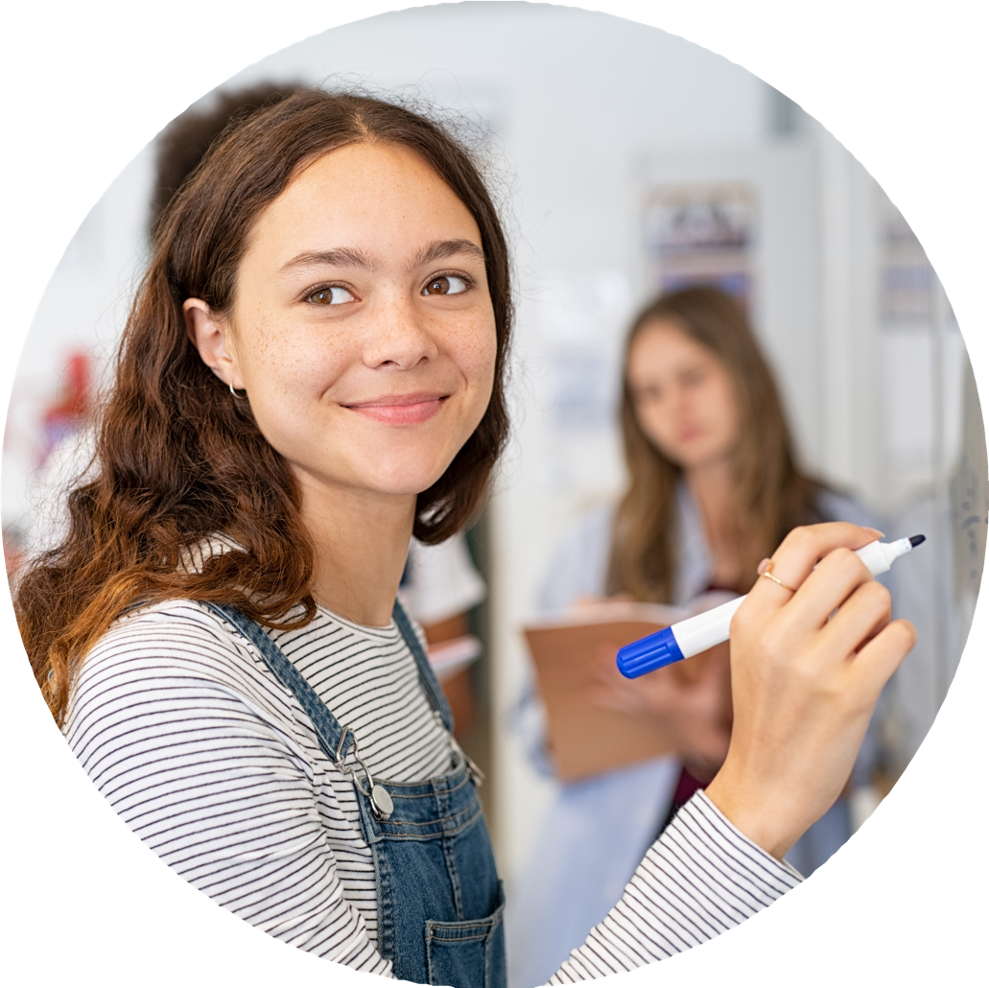
What is The Eurekas?
The Eurekas is part of the Limit Less campaign, which has been conceived by the Institute of Physics to broaden and diversify the range of people doing physics after age 16.
Every child has a unique talent or skill - yet they don’t always get the chance to share it. The Eurekas is an opportunity for all students to shine by tapping into their individual passions and combining it with the world of physics.
Whether you teach art, music, English or PE, all teachers can inspire students to see physics differently. You can motivate young learners by helping them consider where the overlap with physics lies and help showcase their findings in a format they feel comfortable with.
Published 2023

Slide 4
How teachers can get involved
We are looking to teachers to support the Institute of Physics in getting students energised about this challenge. With prizes up for grabs for the students as well as their schools we want as many people as possible to feel included and excited by The Eurekas.
In this document, we’ve laid out some slides that can be used by teachers across the UK and Ireland to help explain what The Eurekas is, and how students can get involved.
Explain to students what The Eurekas is
Direct them towards instructions
Incentivise them with the prizes up for grabs
Show them examples
Feel free to use these slides in lessons or assemblies, to introduce the idea to your classes, and get in touch with us at campaigns@iop.org for any further information.
IMPORTANT TO NOTE
Due to child safeguarding, IOP will only be accepting submissions from teachers and parents/carers. Please look closely at the competition Terms and Conditions for more information.
Published 2023

Slide 5
The Eurekas
See physics differently
Published 2023

Slide 6
Into...
Science
Music
Sport
Art
Something else?
No matter your passion – channel your creativity into something special with The Eurekas.

Slide 7
What is The Eurekas?
The Eurekas is an annual physics competition for students aged 11-16 in the UK and Ireland, where we challenge you to see physics differently.
We want to see submissions that show you interacting with physics creatively and in a way we might not expect. Everyone has a passion. Maybe yours is art, sport, music, gaming or something else – physics will be a big part of how it happens. Decide what you’re most passionate about, then show us how physics plays a part in it.
An inspiring judging panel will determine which entries demonstrate exceptional originality and creativity, with an overall winner receiving £1,000/€1,200, plus £250/€300 for their school. Two runners up will each win £500/€600 and there will be six prizes of £250/€300 awarded to an outstanding entry from someone at every age, from 11 to 16.
Published 2023

Slide 8
Watch the video.
Take a look at The Eurekas video to find out more about the competition.

Slide 9
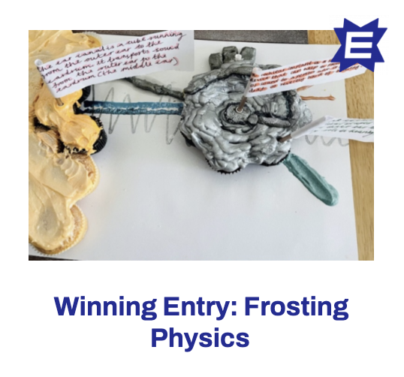
Get inspired
Explore last year’s entries for inspiration: theeurekas.co.uk/get-inspired
Published 2023

Slide 10
Get creative
Think about what your entry might be.
Craft an artwork showing how you would solve a problem, global or local, that you’re passionate about
Make a sculpture of a health device that has made life better for you or someone you love
Direct a video explaining the physics in your favourite sport
Sing a song or play an instrument and explain how physics makes the music happen
Imagine your hero - someone you admire. Explain the physics in what they’re famous for
Sew, bake or build something and show us how physics makes it possible
Power up your favourite game and demonstrate how it uses physics to be realistic
As long as your entry shows how physics powers your passion, you will be in the running for the top prizes.
You can explain this thought process in your covering letter (see Competition Guidelines for more information).
Published 2023

Slide 11
Next steps...
Do you have any ideas off the top of your head? Start jotting them down and get creative!
Ask your teacher or parents/carer for help with ideas and an information on deadlines.
And remember… see physics differently.

